Slide 1

New York City Bike Sharing Demand
Jesse Geman
Sibel Kadıoğlu
Bruce Wang
DATA 1030 Final Project
Supervised by Prof. Dan Potter
Data Science Initiative – Brown University

Slide 2
Overview
13,845,655 recorded Citi Bike trips in New York for the year of 2016
What information lies in the data?

Slide 3
Outline
Part I: Exploratory Data Analysis
Part II: Machine Learning Algorithms
User Perspective
Business Perspective
Part III: Visualizations

Slide 4
Raw Data
Citi Bike Data from New York City
Monthly data from 2016 (12 .csv files)
Every month is ~1 million sample
Each sample represents a particular bike trip
Features are:
start/end station (id, name, lat, long)
user: type (subscriber or other), gender, age
trip: date, start/stop time

Slide 5
Data Augmentation – I
Extended our data with:
Hourly weather data
description: fog/cloudy/sunny etc.
humidity, temperature, wind speed
Census data
Census defined neighborhoods
Median income

Slide 6
Data Cleaning
Month to month discrepancies
Missing values removed
Consistency issues,
Date/Time format mismatch between different data sets
Different representations
Removing redundant features

Slide 7
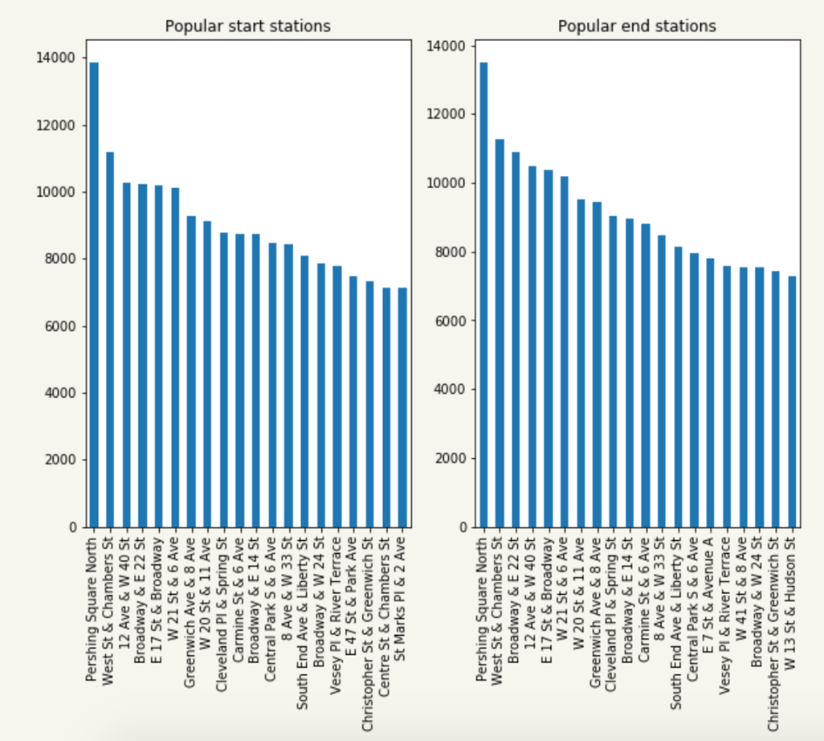
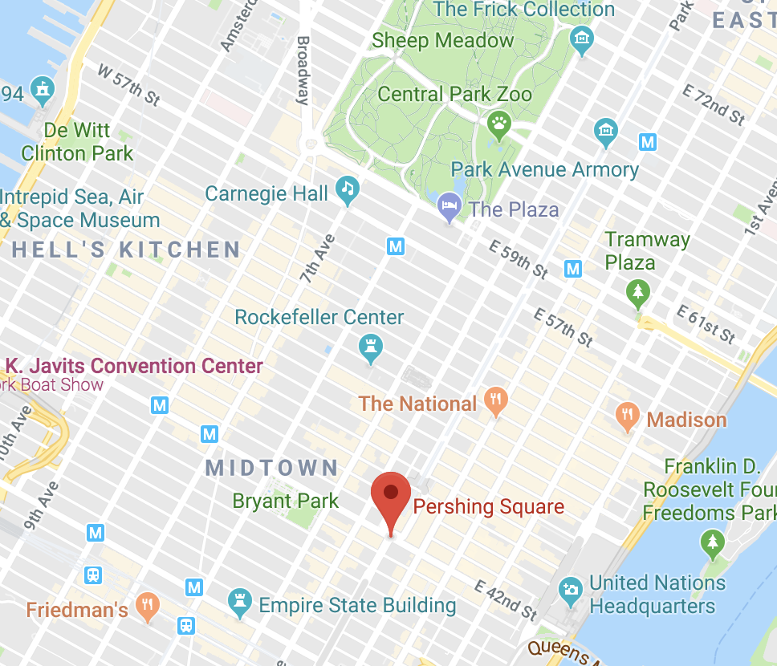
Exploratory Analysis – I
Popular start / end stations
Notes:
We checked does popular start end stations change? July data
populart station does not change bsaed on month

Slide 8
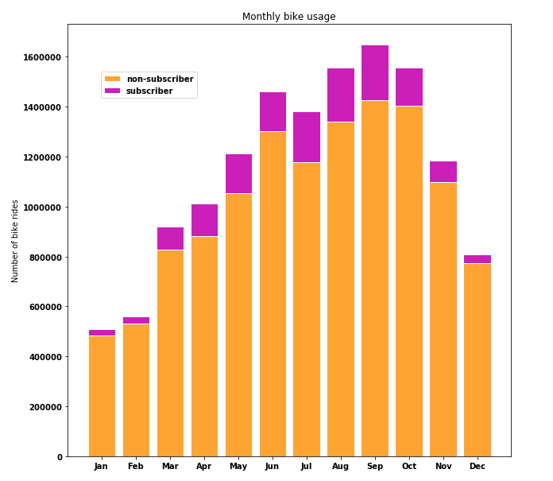
Exploratory Analysis – II
Notes:
stacked bar

Slide 9
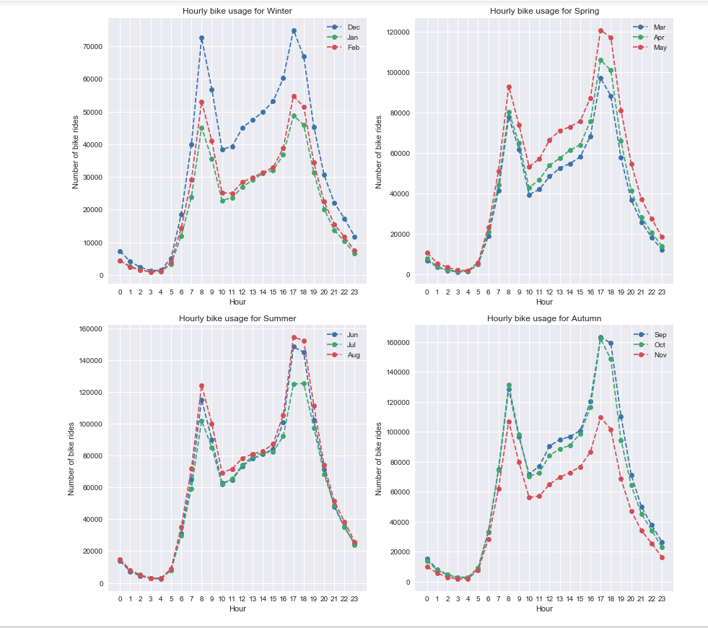
Exploratory Analysis – III

Slide 10
Insights from Data
User Perspective
Where should I go for a bike?
Business Perspective
Can we find patterns within the riders’ trips?

Slide 11
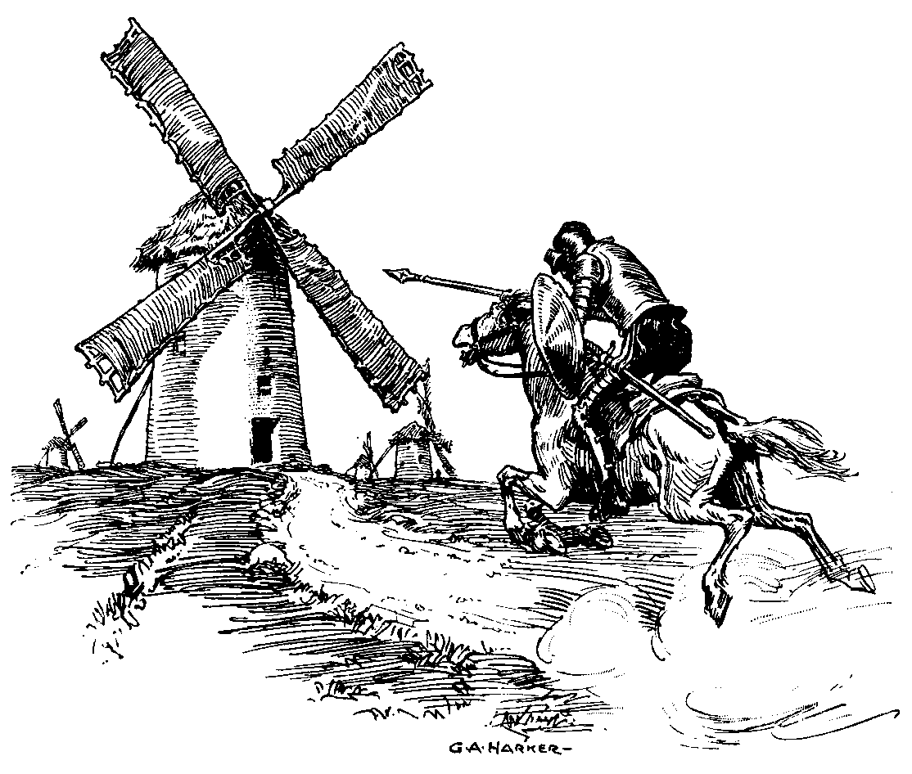
User Perspective

Slide 12
User Perspective – What?
Imagine a user who wants a bike
The user knows
the neighboorhood
the day of the week
the time of the day she needs it.
Question: given a neighborhood / day / time how to recommend the station with the best possibility to rent a bike?

Slide 13
User Perspective – How?
Map NYC neighborhoods (e.g., lower east side, tribeca, east village, etc.) to a set of stations
Next, define a measurement, Delta(n,d,t)
For each station in the given neighborhood
Delta(n,d,t) = Incoming – Outgoing
Incoming: the number of bikes arriving the hour before
Outgoing: the number of bikes leaving the hour before
Higher delta → higher likelihood of finding a bike

Slide 14
Approach – I: Data
Feature vectors:
Bike info
Station id
Date info
hour, day, month, full date
Weather info
description: fog/cloudy/sunny etc.
humidity, temparature, wind speed
New feature, lag
previous specified hour values of target
Target
Outgoing bikes
Incoming bikes

Slide 15
Approach – I:
Monthly data is grouped based on seasons
For each season,
Two month is used as training data
The remaining one month is used as test data
Cross validation over each month of season
Target: Predicting outgoing/incoming bikes for each station
for a given date and hour

Slide 16
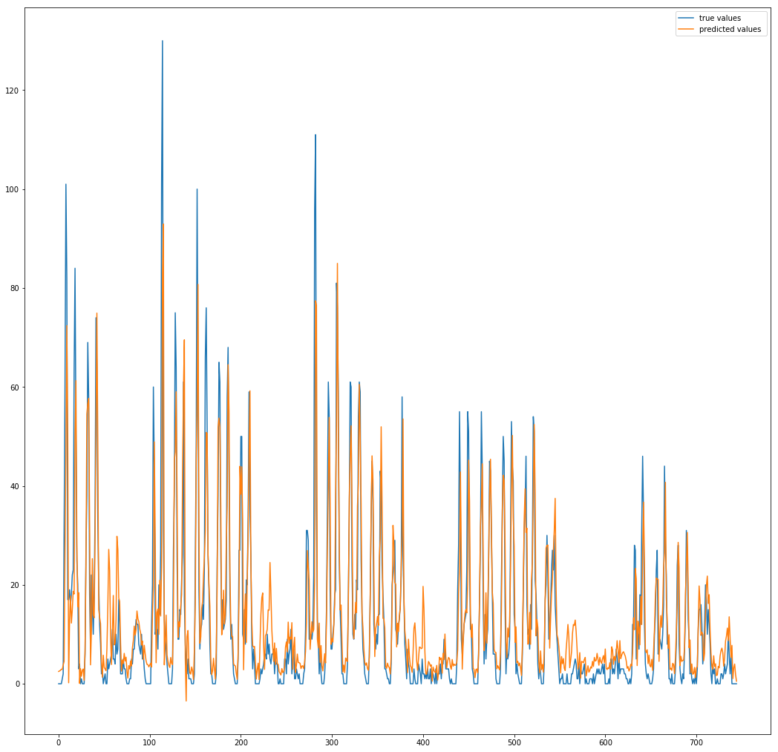
Approach – I: Result
ALGORITHMS | LAG | MAE | SPEARMAN CORR. COEFF. | PEARSON CORR. COEFF.
Linear Regression | 48 | 5.57 | 0.741 | 0.853
Decision Tree Regression | 40 | 5.05 | 0.817 | 0.844
Support Vector Machine Reg. | 48 | 4.86 | 0.803 | 0.847
The most popular station’s
outgoing bikes in Winter
Number of outgoing bike rides
Notes:
patterns are similar, prediction values are highly mimic the true values/

Slide 17
Approach – II:
Monthly data is grouped based on seasons
For each season,
Two month is used as training data
Rest one month is used as test data
Cross validation over each month of season
Target: Predicting total outgoing/incoming bikes for a given date and hour

Slide 18
Approach – II: Result
ALGORITHMS | LAG | MAE | SPEARMAN CORR. COEFF. | PEARSON CORR. COEFF.
Linear Regression | 40 | 161.48 | 0.950 | 0.953
Decision Tree Regression | 2 | 157.86 | 0.971 | 0.925
Support Vector Machine Reg. | 40 | 215.00 | 0.933 | 0.895
Winter Incoming Bikes
ALGORITHMS | LAG | MAE | SPEARMAN CORR. COEFF. | PEARSON CORR. COEFF.
Linear Regression | 35 | 171.36 | 0.957 | 0.906
Decision Tree Regression | 24 | 120.16 | 0.973 | 0.928
Support Vector Machine Reg. | 48 | 212.13 | 0.923 | 0.895
Winter Outgoing
Bikes
Notes:
it differes quite alot
we tuned hyparameters lag
best result for every row after hyperparamter tuning
after tuning lag values, we observe how it differes between algorithms from 2 to 40?

Slide 19
Business Perspective

Slide 20
Approach – I: Data
Feature vectors:
Bike info
Station id
Date info
hour, day, month, full date
Weather info
description: fog/cloudy/sunny etc.
humidity, temparature, wind speed
Census defined data
Median neigborhood income
Neighborhood of stations
Target
End nhood

Slide 21
Approach – I: Predicting Destination
Predicting riders destination
Which demographic groups commute where?

Slide 22
Approach – I: Predicting Destination
The Process:
Created 4 distinct datasets for each season
Converted all non-numeric categorical values to numbers
Selected demographic groups to examine (e.g. Females, Citi Bike subscribers, born after 1988)
Built, trained, and optimized Decision Tree and Random Forest classifiers on subsets of the data and tested on holdout sets.

Slide 23
Approach – I: How We Did?
40 neighborhoods to choose from
We were able to predict with up to 65 percent accuracy where certain demographic groups were going.
How good is that?
Notes:
By December of 2016 There were 40 neighborhoods with Citi Bike stations. The number grew throughout the year as the program expanded
Results dropped hugely when we took away trip duration.

Slide 24
Approach – I: Results
Pretty Good
Litmus test:
Guessed the most common end neighborhood for given start bike station and filtered demographic data:
Result: 37%
Random Forest with no demographic filtering: 38%
Random Forest with demographic filtering: 65%
Decision Tree with demographic filtering: 52%
KNN with demographic filtering: 48%
The catch : limited scope
Results were only impressive for the morning commute
Notes:
One thing that’s cool and is worth noting, was that our dataset was big enough so that there was very little variation in our models from one train/test result to another.

Slide 25
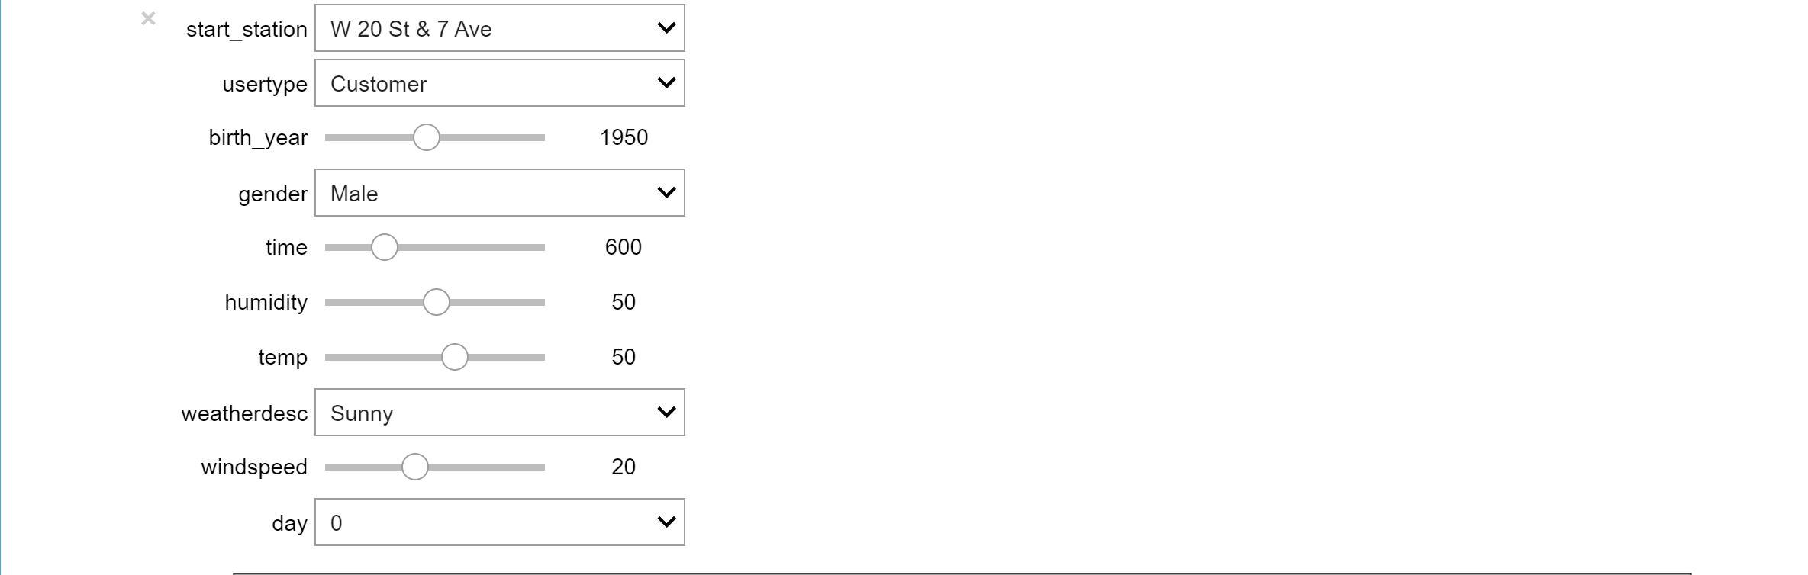
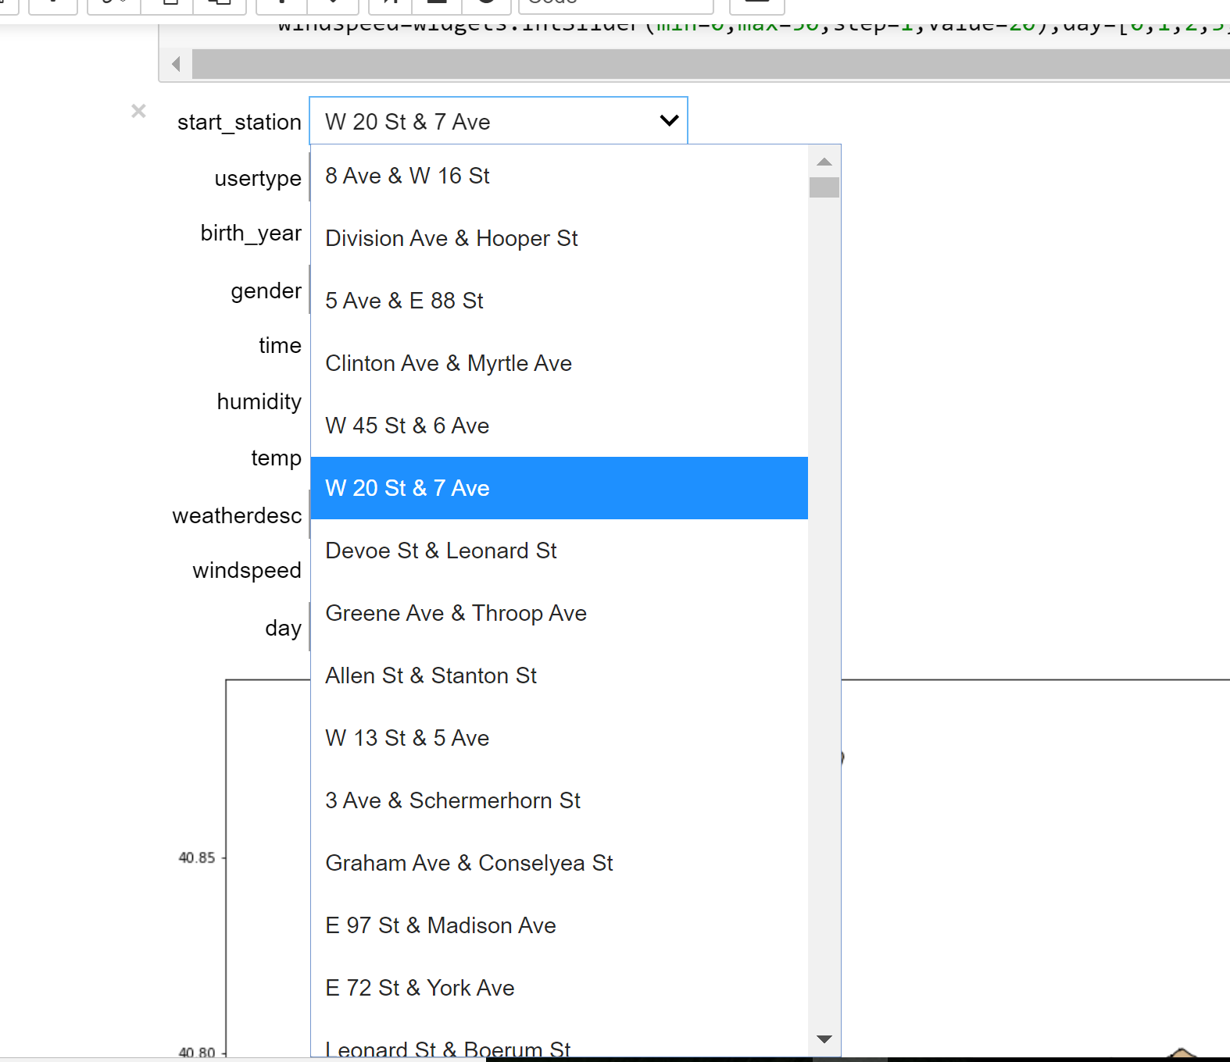
Approach – I: User API
Takes in user inputs through the form of sliding bars for numeric values, and dropdown menus for categorical values.

Slide 26
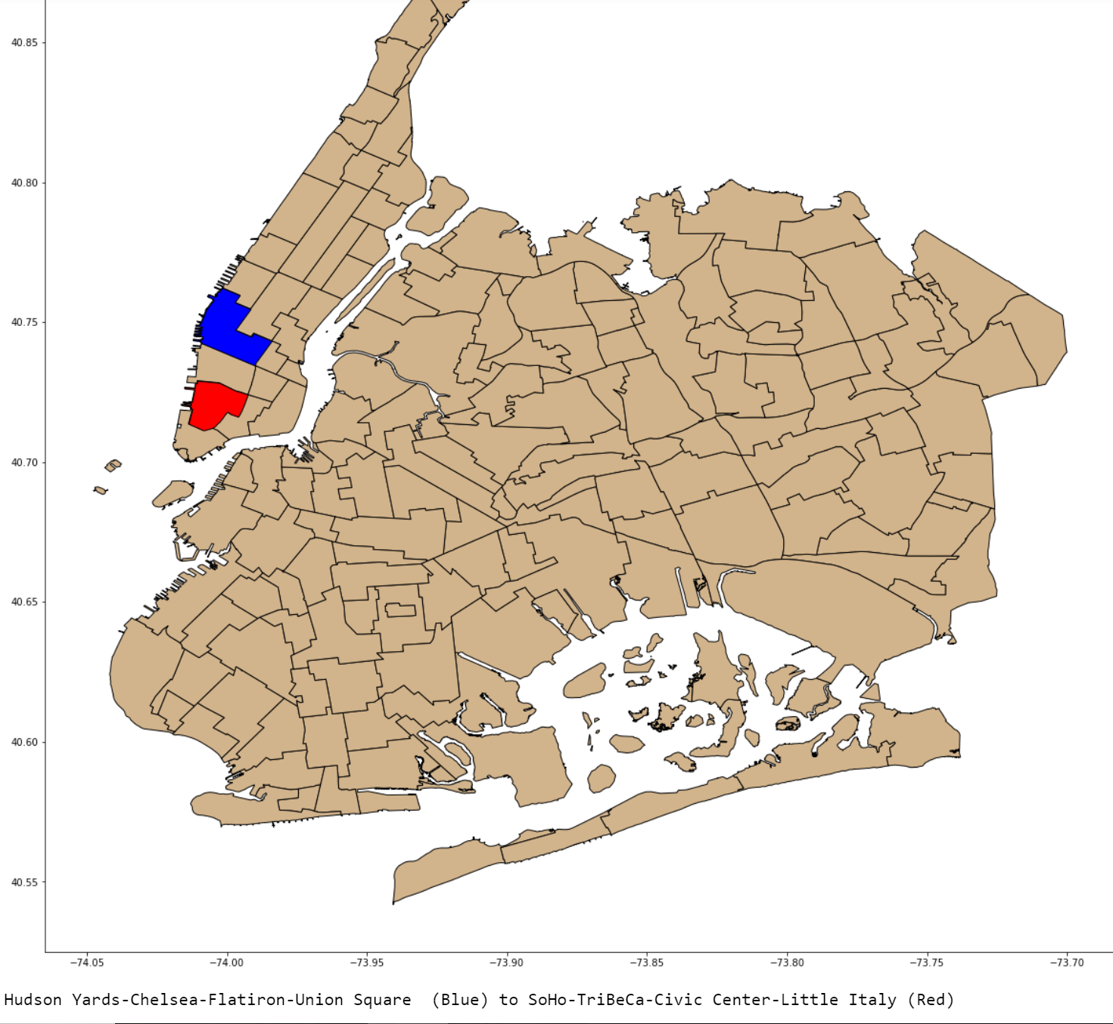
Approach – I: User API
Outputs predicted end neighborhood on a map (via the predictive algorithm), and the start neighborhood.

Slide 27
Approach – II: Data
Feature vectors:
Bike info
Station id
Date info
hour
Computed Traffic Data
End-start ratio (2.5*log(Incoming traffic/outgoing traffic))
Adjusted Incoming and Outgoing traffic data:
#Incoming bikes/85th percentile of the max of all incoming bikes for that hour
#Outgoing bikes/85th percentile of the max of all incoming bikes for that hour
Target
Clustered traffic
nhood

Slide 28
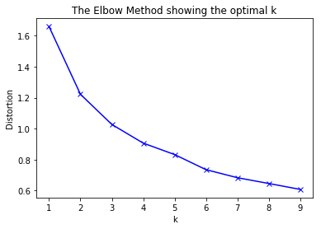
Approach – II
After pre-processing, the data was clustered via the k-means algorithm.
Optimal number of clusters were determined via the ‘elbow-method’

Slide 29
Approach – II
Optimal number of clusters was determined to be 6.
Data was segmented into different time period throughout the day:
Early Morning (100-500), Morning (600-1000), Afternoon (1100-1400), Evening (1500-2000), Night (2100-0)
K-means was then run on these segmented data

Slide 30
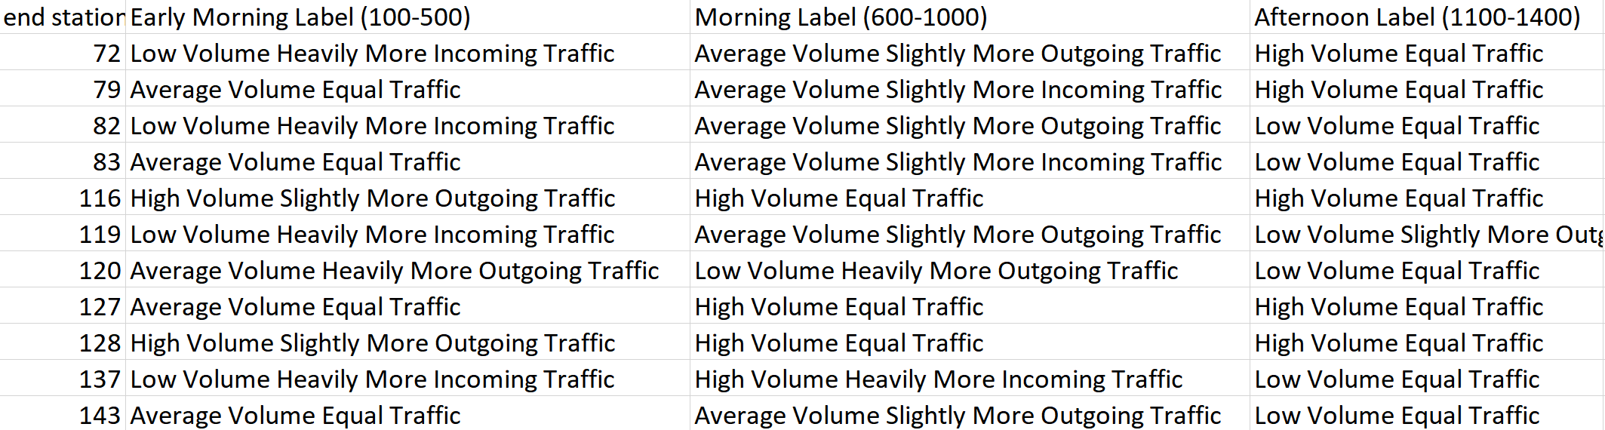
Approach II: Results
Several criterion for naming clusters:
Volume (Absolute number of bikes going through a station)
Traffic Proportion (Are there more bikes going out, or in?)

Slide 31
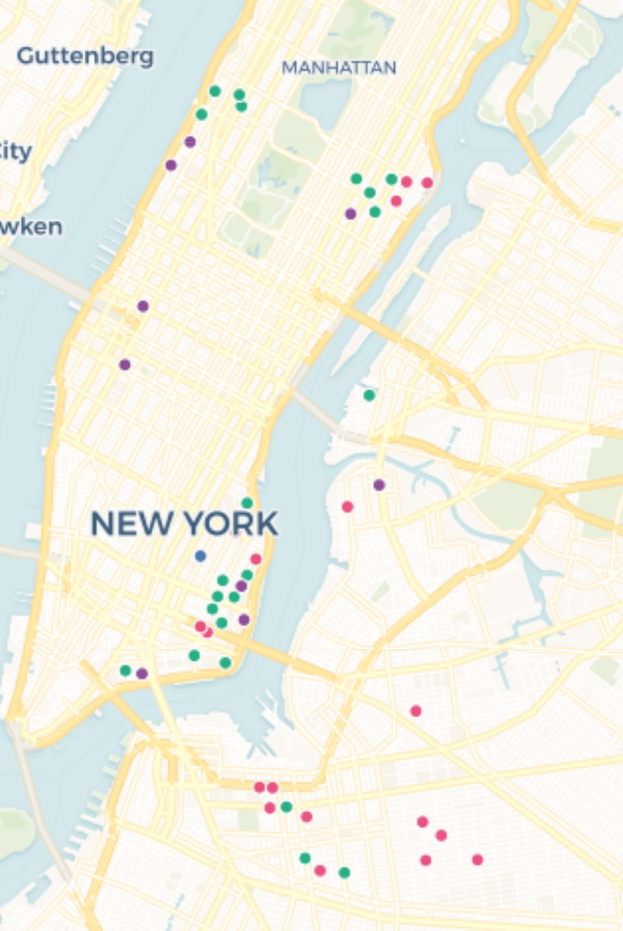
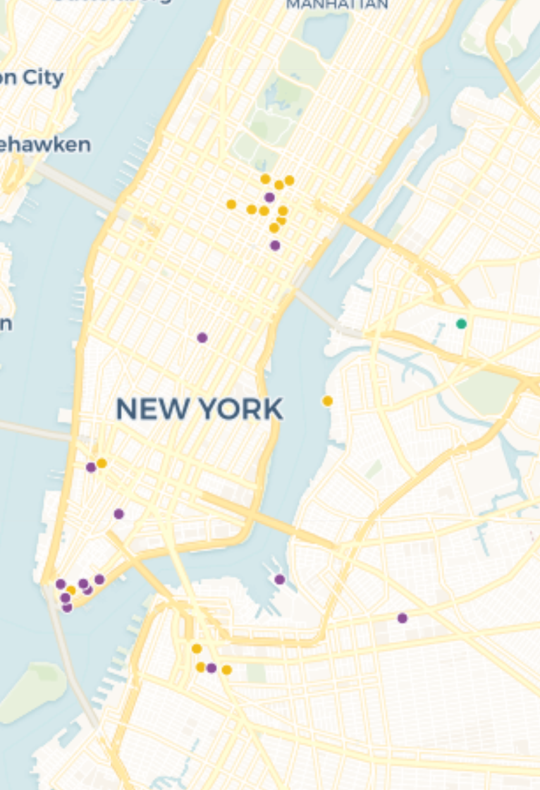
Approach II: Results
Stations with a high volume of more outgoing traffic in the morning (commuting/residential stations) had a strong overlap with stations of a high volume of more incoming traffic (and vice- versa).
“Starting Commuting Stations”
“Ending Commuting Stations”

Slide 32
Approach II: Results
Demo

Slide 33

Thank you ☺

Slide 34
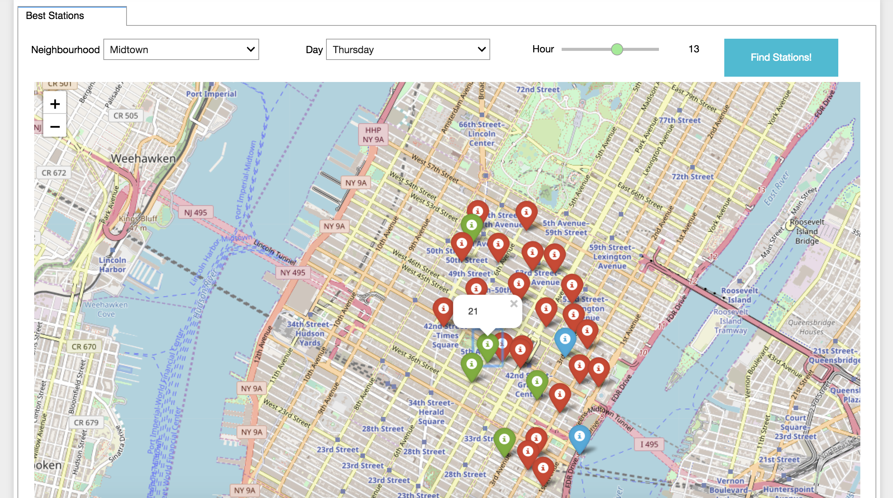
A) User Perspective – How?

